Slide 1



NATIONAL SCHOOL DATA DASHBOARD
A Comprehensive Analysis of Student Demographics and Staffing Metrics

Slide 2
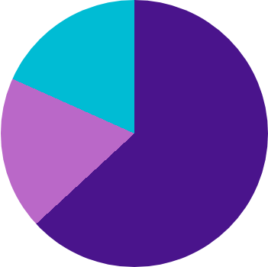

WORKFORCE SECTOR DISTRIBUTION
Government: 63.15% (3.06M)
100%
Catholic: 18.56% (0.9M)
Total Staff
Independent: 18.29% (0.89M)
The workforce is heavily concentrated in the Government sector, representing nearly two-thirds of the total national educational staff.

Slide 3
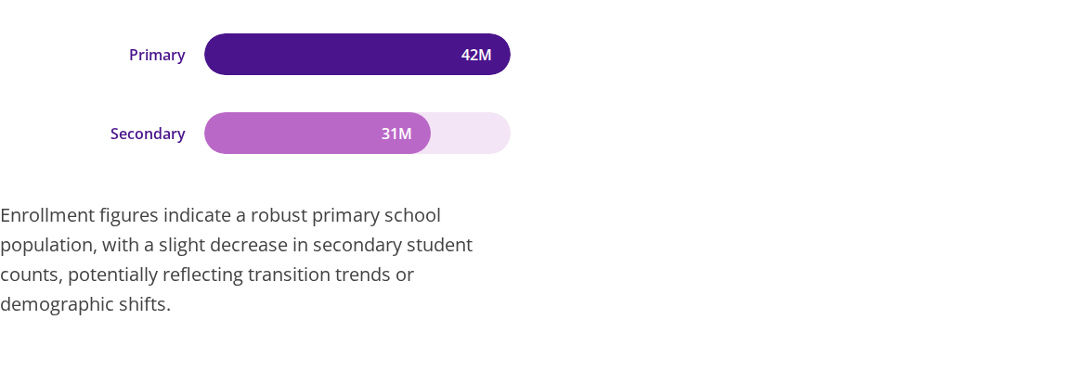


STUDENT ENROLLMENT BY LEVEL

Slide 4



GENDER DISTRIBUTION ANALYSIS
Primary Level
Secondary Level
43M Total
31M Total
Female: 21M
Female: 15M
Male: 22M
Male: 16M
Gender parity is maintained across both educational levels, with a near 50/50 split between male and female students.

Slide 5
STATE-LEVEL ENROLLMENT (TOP REGIONS)
State/Territory | Catholic Sector Students | Government Sector Students | Total Combined
New South Wales | 4,999,573 | 15,274,957 | 20,274,530
Victoria | 4,017,943 | 11,368,303 | 15,386,246
Queensland | 2,805,465 | 10,345,697 | 13,151,162
South Australia | 948,646 | 3,384,012 | 4,332,658
*Figures derived from national school sector reported data.

Slide 6
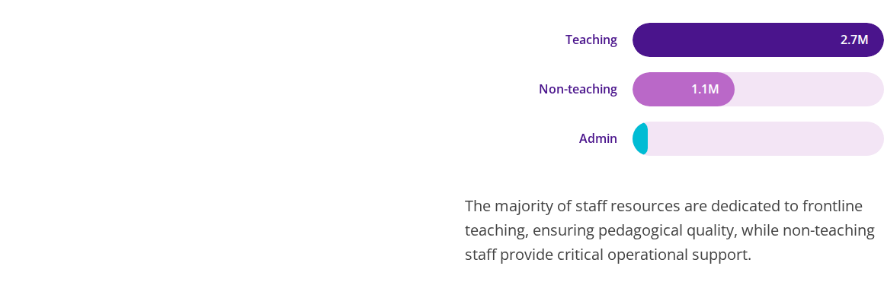

WORKFORCE ALLOCATION BY FUNCTION

Slide 7
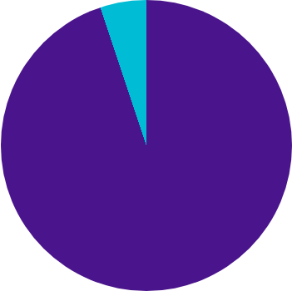

INCLUSIVITY: INDIGENOUS REPRESENTATION
Non-Indigenous: 94.87% (69.64M)
5.13%
Indigenous: 5.13% (3.77M)
Indigenous
Targeted educational programs and funding continue to focus on the 5.13% Indigenous student population to ensure equitable outcomes and cultural integration.

Slide 8

Any Questions?
Thank you for your attention to the National School Data Overview.
Contact: data.admin@schoolboard.edu | www.schooldashboard.gov

